Slide 1
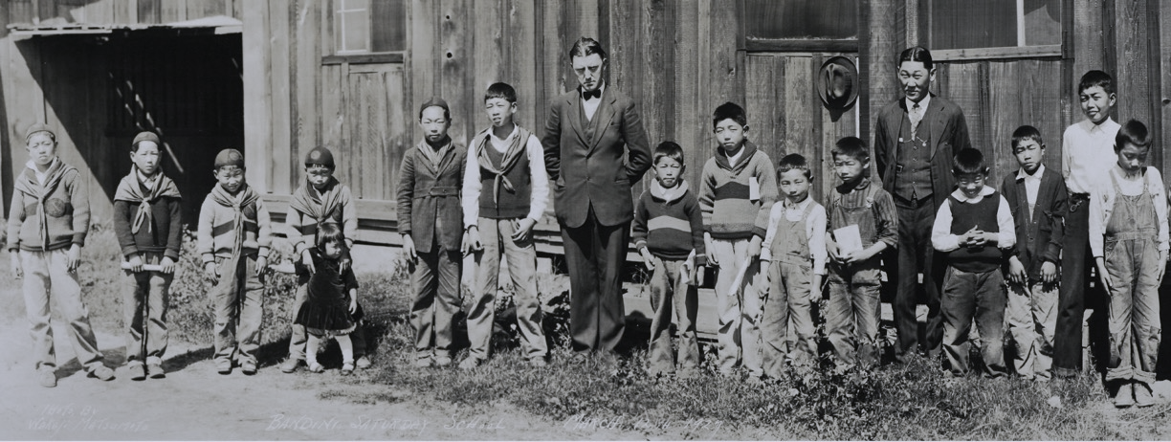
A picture is worth a 1,000 words…
Strategies for using Wakaji Matsumoto’s photographic images
in your classroom
Activities designed to accompany Wakaji Matsumoto: An Artist in Two Worlds online exhibition at the Japanese American National Museum.
All activities by Karen Matsuomto, granddaughter of Wakaji Matsumoto and exhibition project liaison.
Notes:
Photo: Wakaji Matsumoto, Bandini Saturday School, Commerce, CA, circa 1927.
Activities designed to accompany Wakaji Matsumoto: An Artist in Two Worlds online exhibition at the Japanese American National Museum. All activities by Karen Matsuomto, granddaughter of Wakaji Matsumoto and exhibition project liaison.

Slide 2
Strategy 1: Revealing sections
Have students note what they see after each
section is revealed
This helps them to focus on details within
the image
As more of the photograph is revealed, move
from concrete observations to inferences

Slide 3
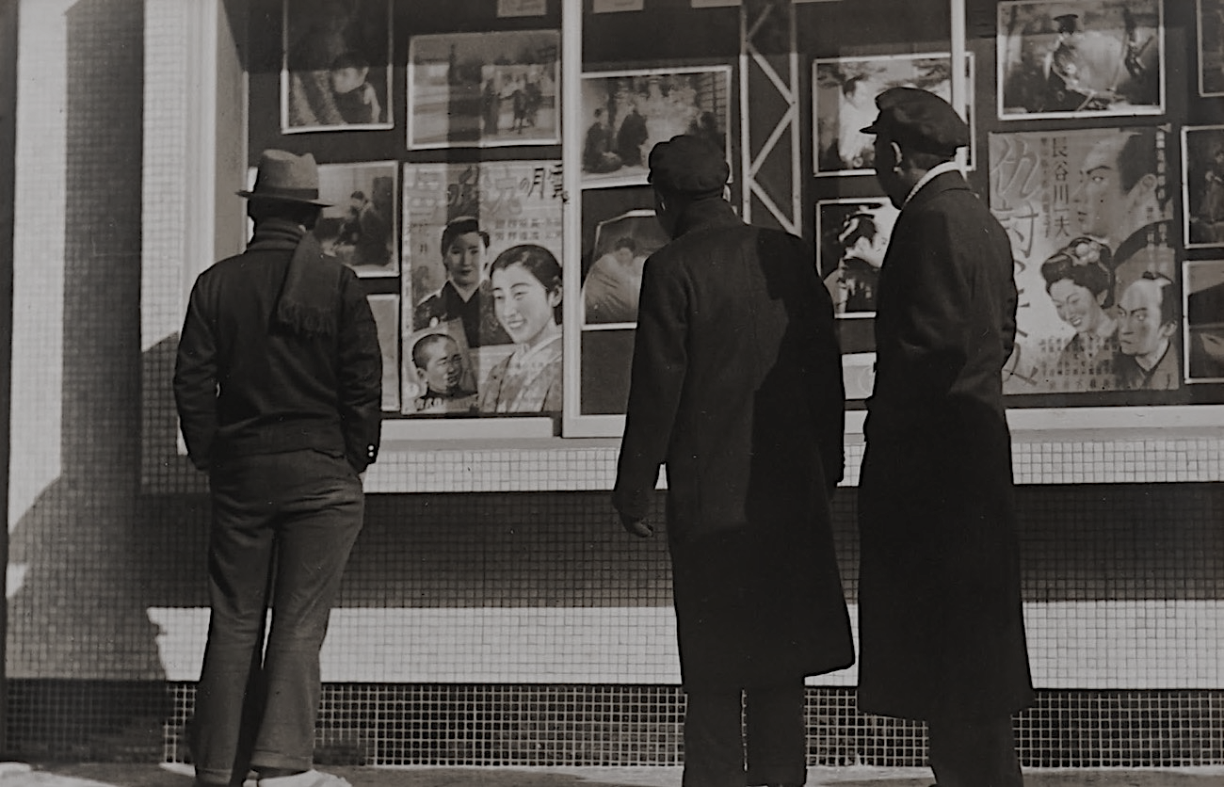
Notes:
Photo: Wakaji Matsumoto, Men viewing movie posters, Hiroshima, Japan, circa 1935.

Slide 4
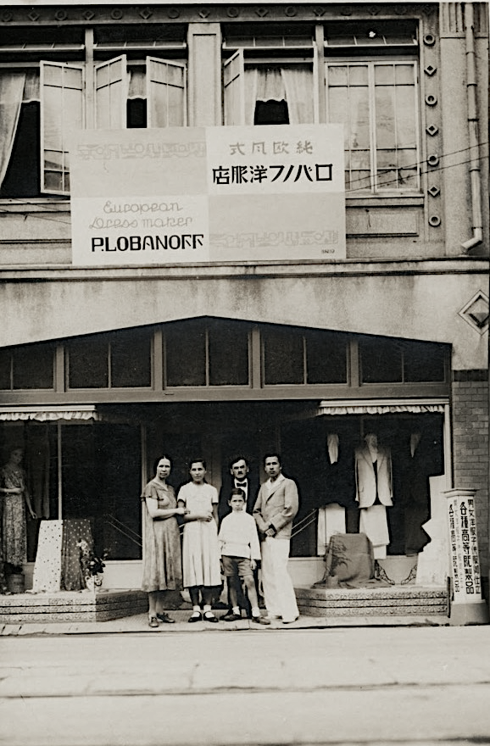
Notes:
Photo: Wakaji Matsumoto, Dress shop owned by Russian Jewish family in Hiroshima, Japan circa 1935.

Slide 5
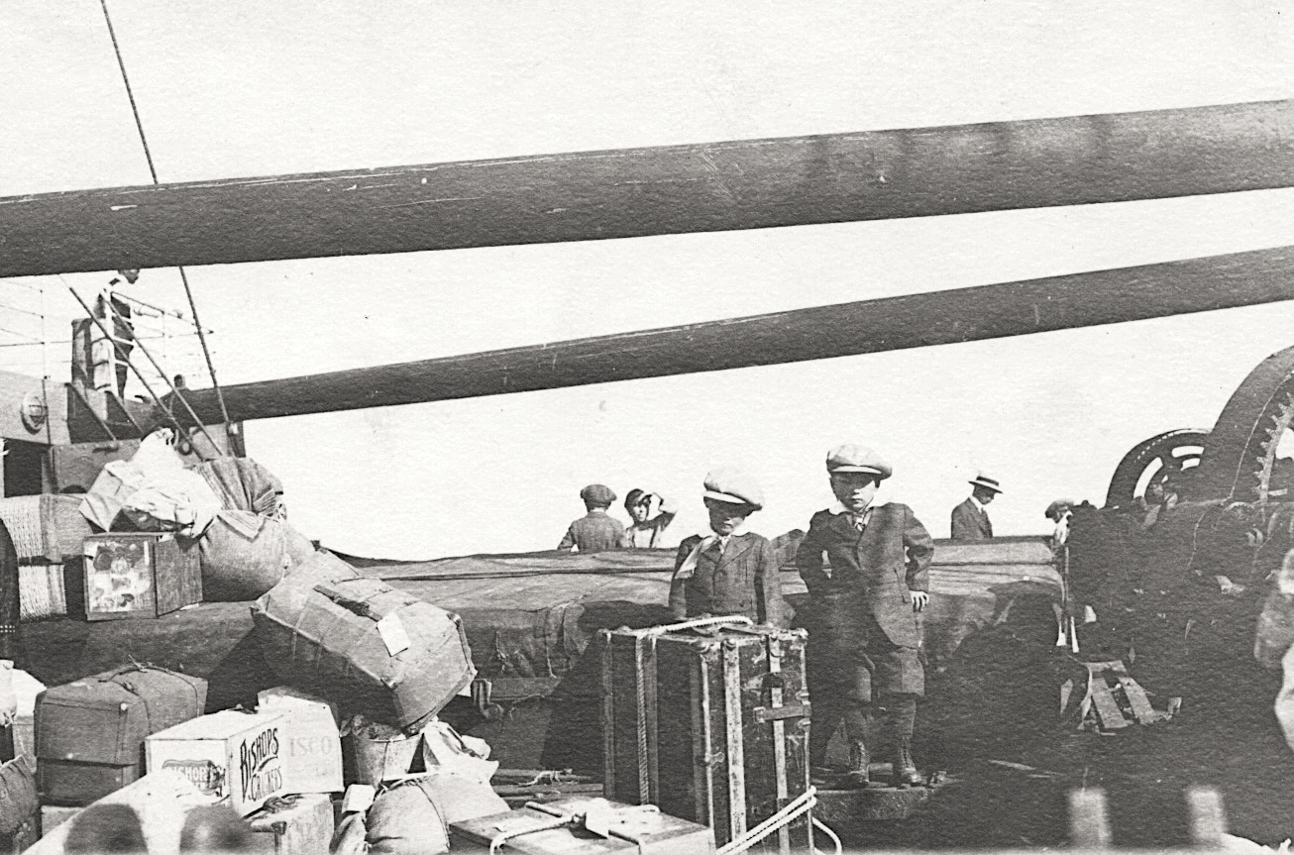
Notes:
Photo: Wakaji Matsumoto, Sons going back to Japan on steamship from San Pedro, CA, 1920.

Slide 6
Strategy 2: Stepping into the image
As you show each photo, ask students to record their thoughts about each question as you ask it out loud:
What do you see? (clothing, items, who?, what?)
What do you hear? (conversations, sounds, words,
phrases)
What do you smell?
What do you feel? (physical feelings, emotional feelings)
What is going on? (Make some inferences.)

Slide 7
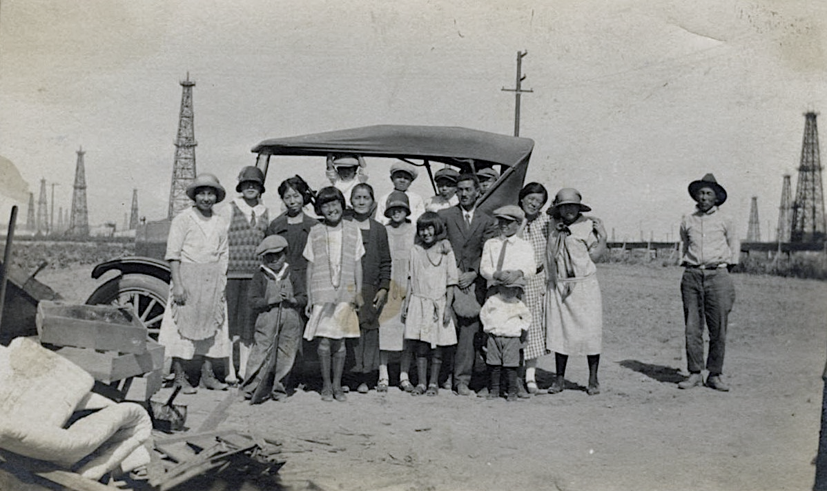
Notes:
Photo: Wakaji Matsumoto, Japanese immigrant family in Los Angeles, CA circa 1925.

Slide 8
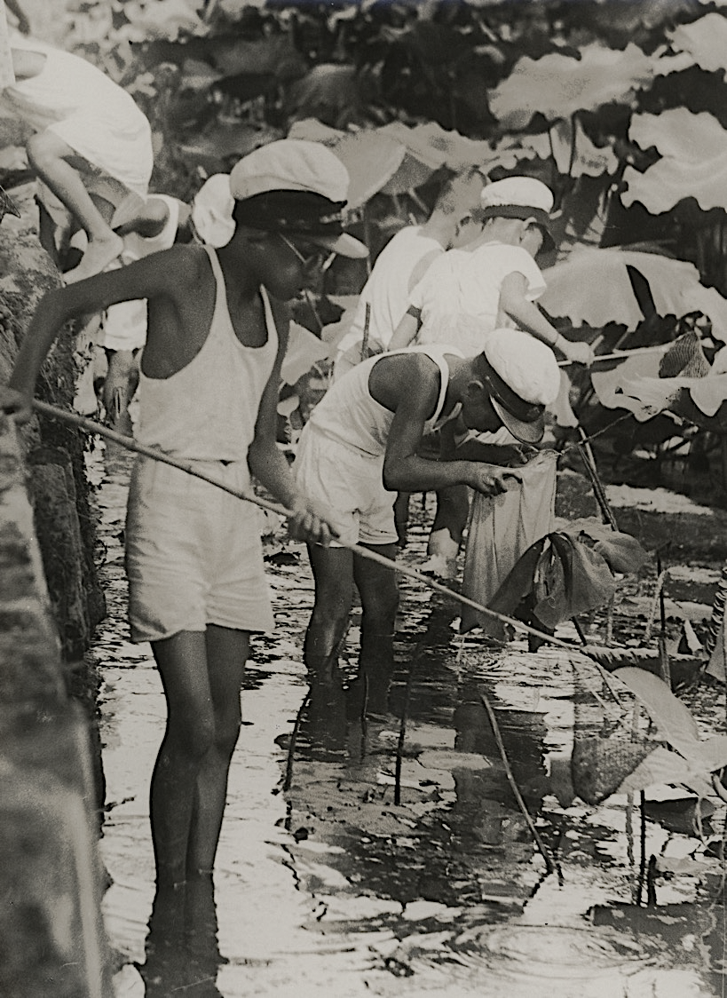
Notes:
Photo: Wakaji Matsumoto, School children using nets to catch pond life, Hiroshima, Japan, circa 1935.

Slide 9
Notes:
Photo: Wakaji Matsumoto, Wakaji Matsumoto farm, Los Angeles, CA circa 1919.

Slide 10
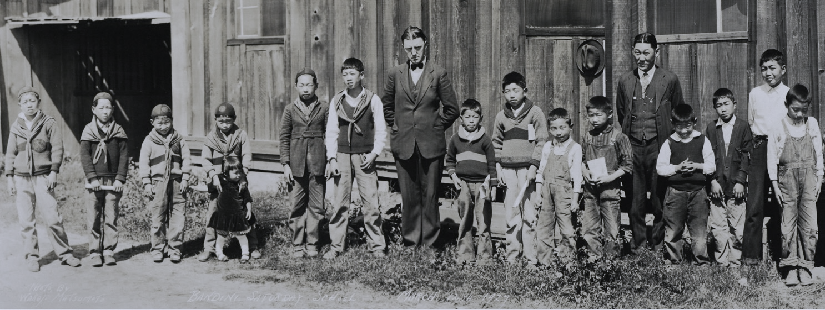
Notes:
Photo: Wakaji Matsumoto, Bandini Saturday School, Commerce, CA, 1927.

Slide 11
Strategy 3: Compare and Contrast
Make a comparison of two presented images
Have students draw a t-chart*
On the left side have them write observations about
what they see (evidence) in the first image
On the right side have them write observations
about what they see (evidence) in the second image
Discuss similarities and differences
Go from observations to inferences
Notes:
*Or use the provided Comparing Images Worksheet

Slide 12
Photo Sets
The photo sets compare various scenes and events in Los Angeles, CA and Hiroshima, Japan.
Photo Set 1: Two parade scenes in Little Tokyo, Los Angeles, CA.
Photo Set 2: Beach scenes in Los Angeles, CA and Hiroshima, Japan
Photo Set 3: Japanese funerals in Los Angeles, CA and Hiroshima, Japan
Photo Set 4: Farms in Los Angeles, CA and Hiroshima, Japan
Photo Set 5: Family portraits in Los Angeles, CA and Hiroshima, Japan

Slide 13
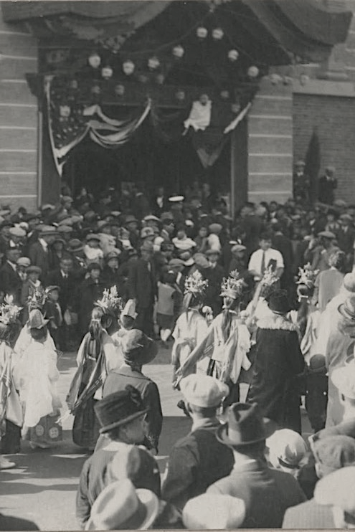
Notes:
Photo Set 1 Image A
Photo: Wakaji Matsumoto, Parade in front of Nishi Hongwanji Temple, Los Angeles, CA, circa 1925.

Slide 14
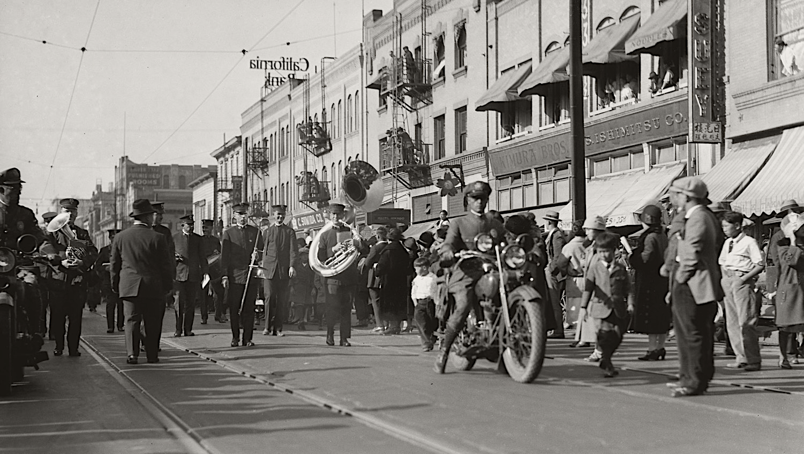
Notes:
Photo Set 1 Image B
Photo: Wakaji Matsumoto, Parade in Little Tokyo, Los Angeles, CA circa 1926.

Slide 15
Notes:
Photo Set 1
Left (Image A): Wakaji Matsumoto, Parade in front of Nishi Hongwanji Temple, Los Angeles, CA, circa 1925.
Right (Image B): Wakaji Matsumoto, Parade in Little Tokyo, Los Angeles, CA circa 1926.

Slide 16
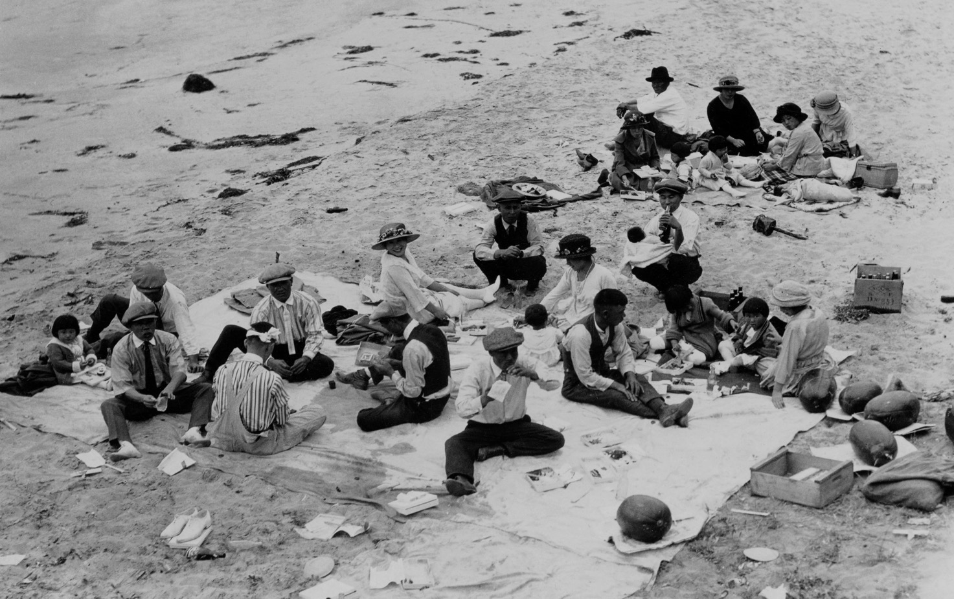
Notes:
Photo Set 2 Image A
Photo: Wakaji Matsumoto, Beach picnic at a Los Angeles area beach, Los Angele, circa 1925.

Slide 17
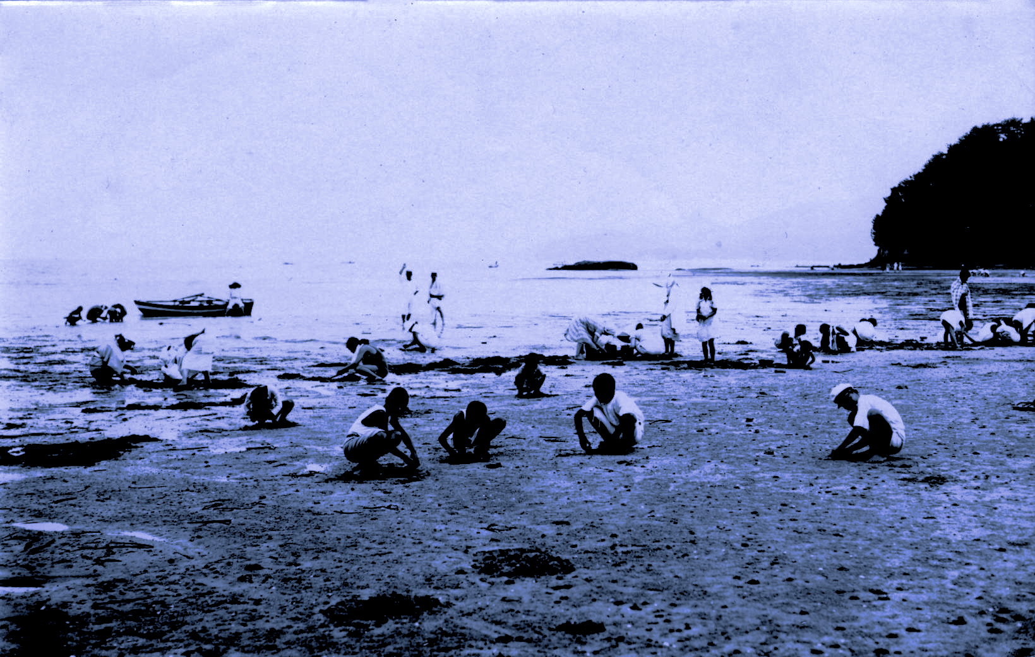
Notes:
Photo Set 2 Image B
Photo: Wakaji Matsumoto, Clam digging at a beach in Hiroshima, Japan, circa 1935.

Slide 18
Notes:
Photo Set 2
Left (Image A): Wakaji Matsumoto, Beach picnic at a Los Angeles area beach, Los Angele, circa 1925.
Right (Image B): Wakaji Matsumoto, Clam digging at a beach in Hiroshima, Japan, circa 1935.

Slide 19
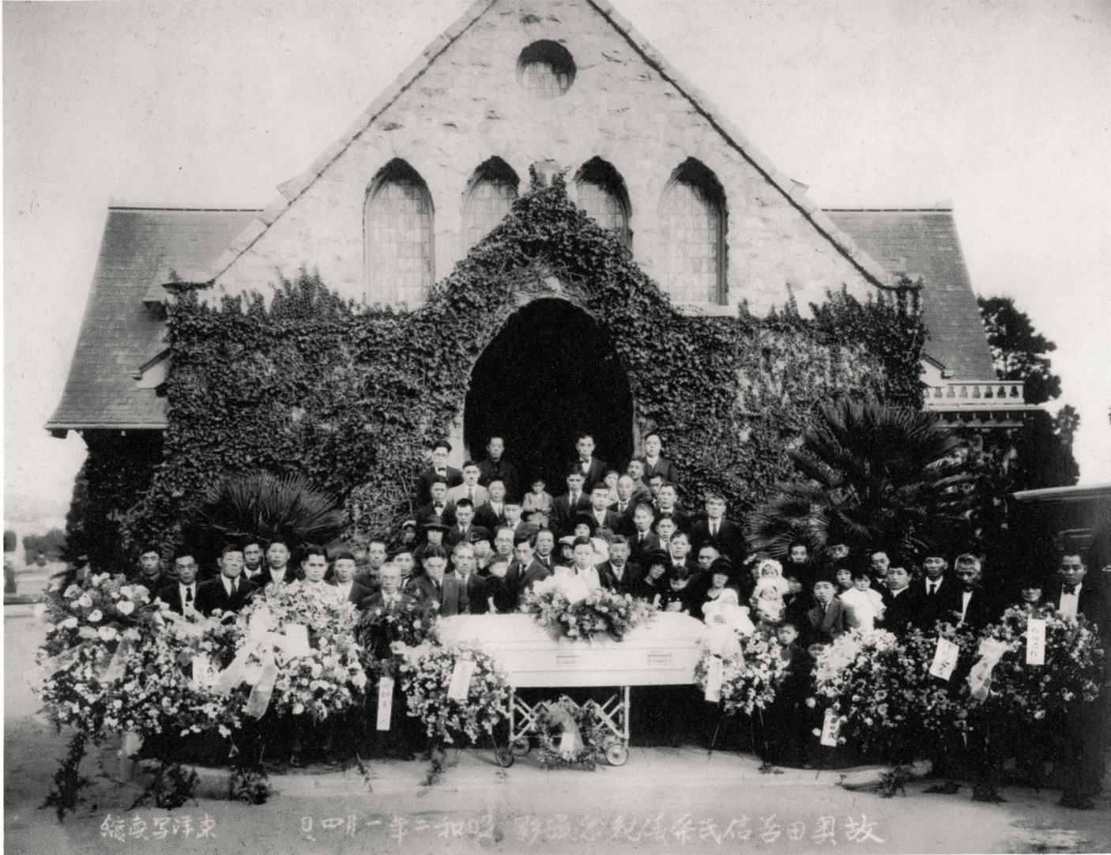
Notes:
Photo Set 3 Image A
Photo: Wakaji Matsumoto, Japanese Funeral at Boyle Heights Cemetery, Los Angeles, CA, circa 1925.

Slide 20
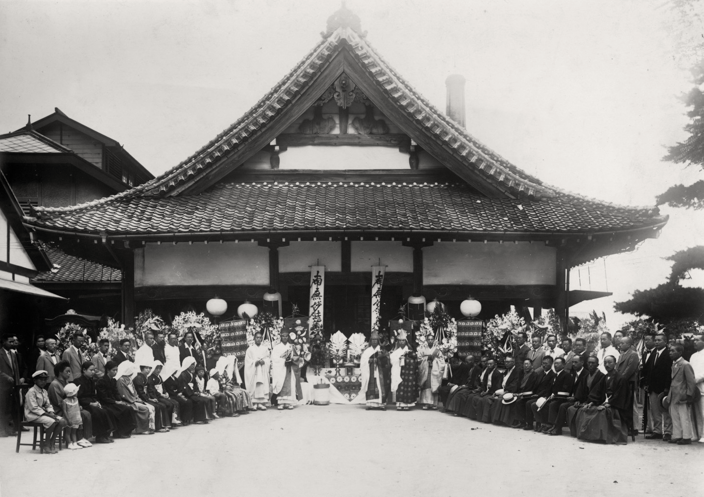
Notes:
Photo Set 3 Image B
Photo: Wakaji Matsumoto, Funeral at Buddhist temple, Hiroshima, Japan. [DATE]

Slide 21
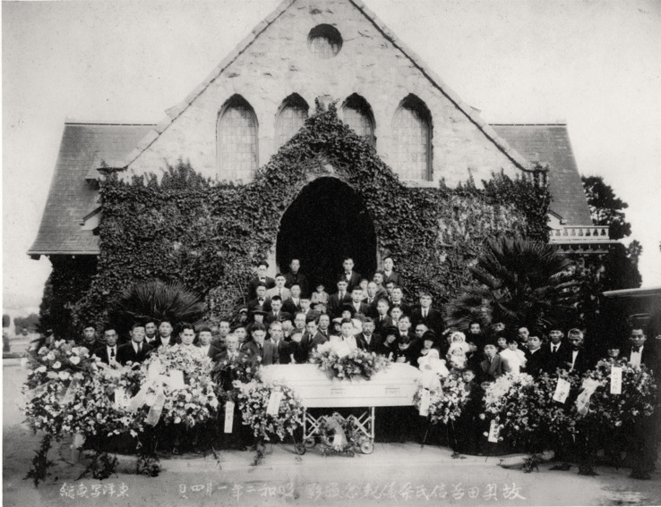
Notes:
Photo Set 3
Left (Image A): Wakaji Matsumoto, Japanese Funeral at Boyle Heights Cemetery, Los Angeles, CA, circa 1925.
Right (Image B): Wakaji Matsumoto, Funeral at Buddhist temple, Hiroshima, Japan. [DATE]

Slide 22
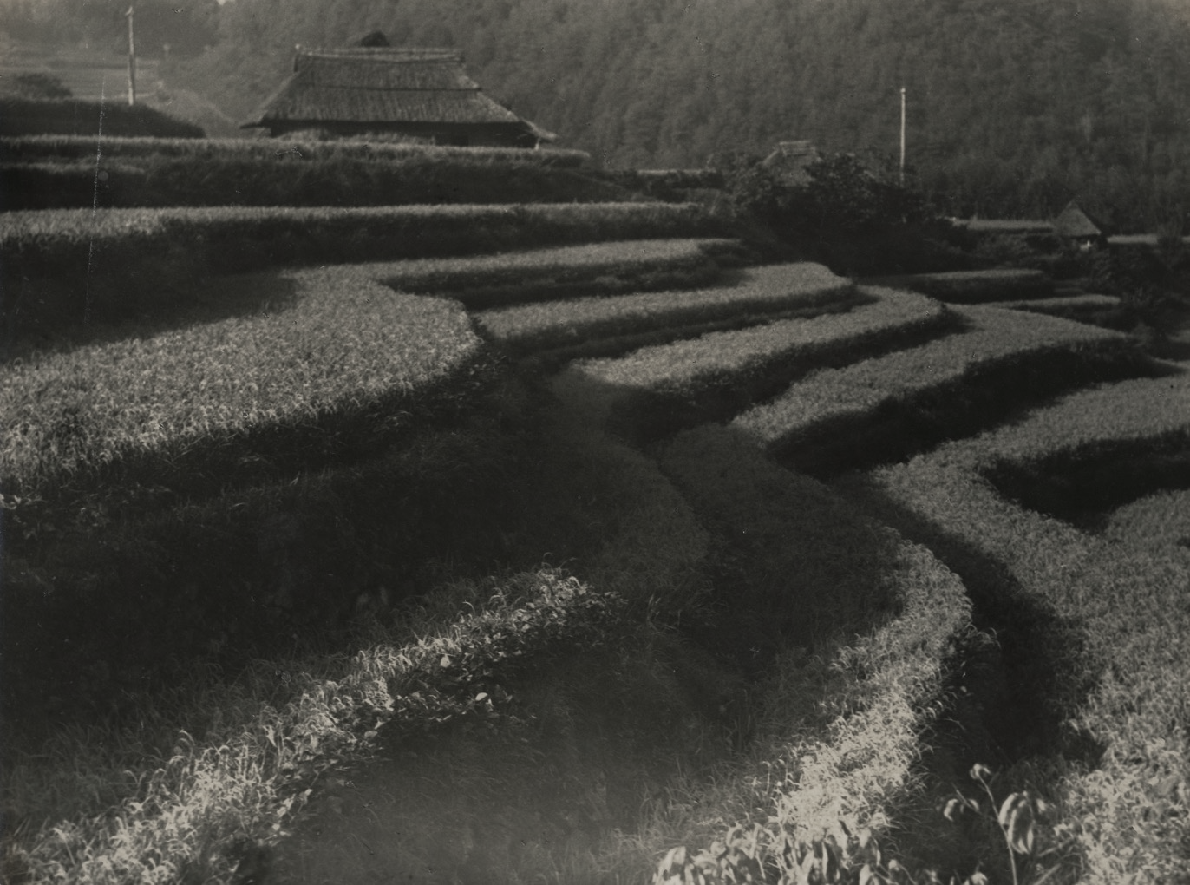
Notes:
Photo Set 4 Image A
Photo: Wakaji Matsumoto, Terraced farm and farmhouse in Hiroshiima, Japan, Hiroshima Prefecture. [DATE]

Slide 23
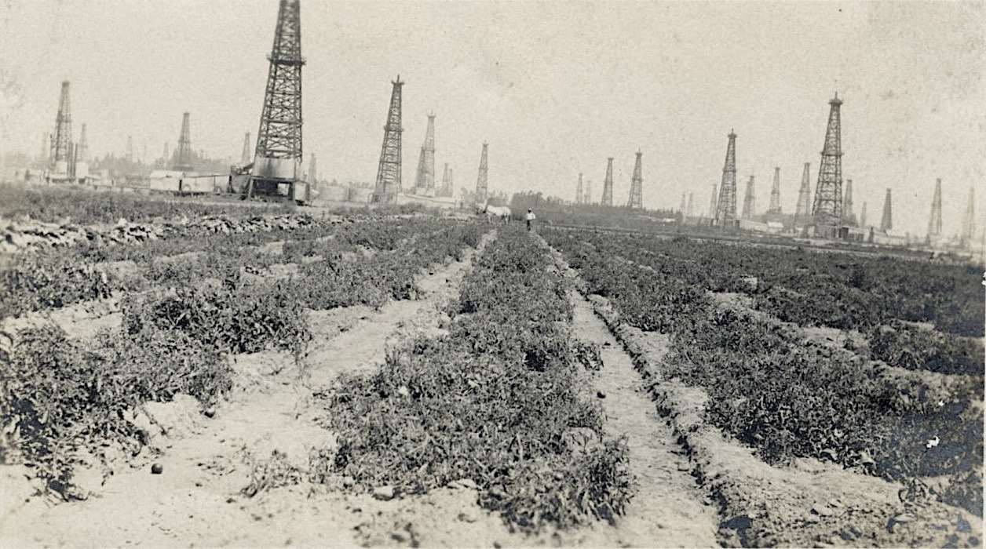
Notes:
Photo Set 4 Image B
Photo: Wakaji Matsumoto, Japanese sharecropper farm, Los Angeles, 1925.

Slide 24
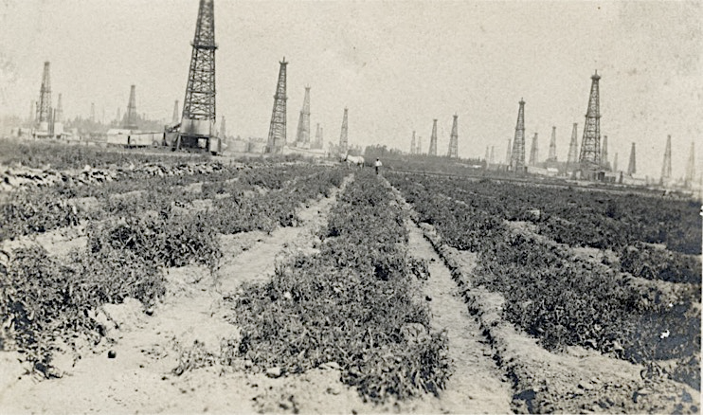
Notes:
Photo Set 4
Left (Image A): Wakaji Matsumoto, Terraced farm and farmhouse in Hiroshiima, Japan, Hiroshima Prefecture. [DATE]
Right (Image B): Wakaji Matsumoto, Japanese sharecropper farm, Los Angeles, 1925.

Slide 25
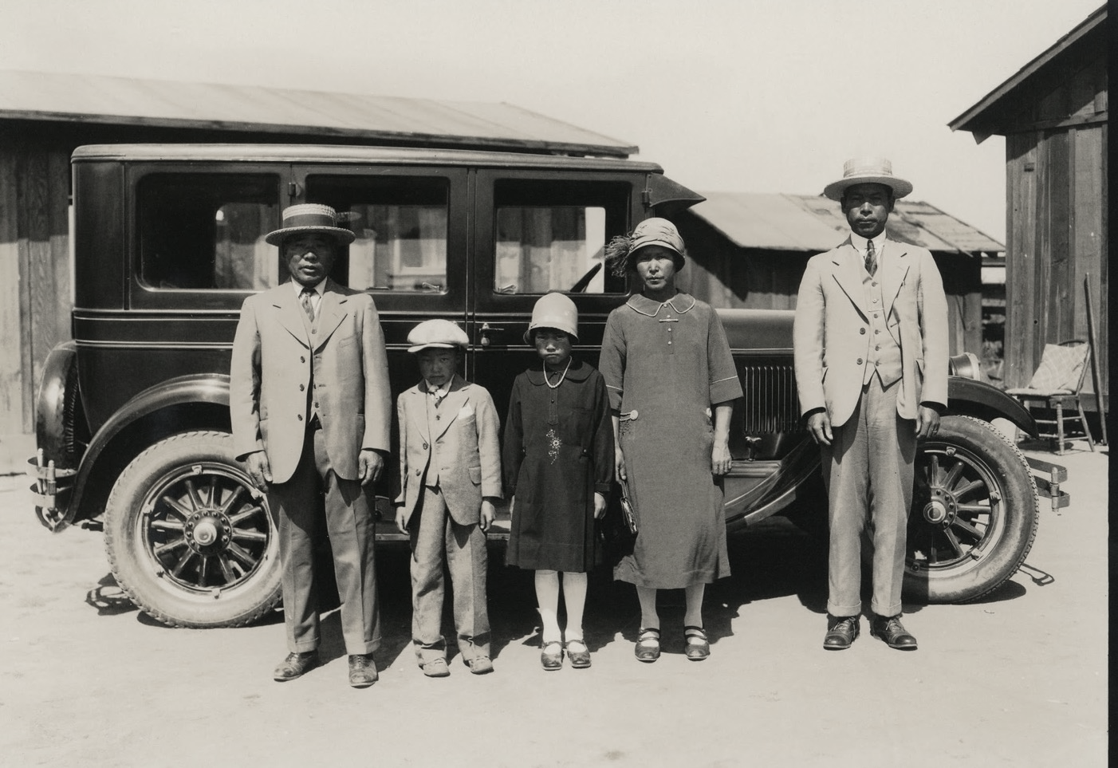
Notes:
Photo Set 5 Image A
Photo: Wakaji Matsumoto, Japanese immigrant family at Los Angeles farm, Los Angeles, CA, 1927.

Slide 26
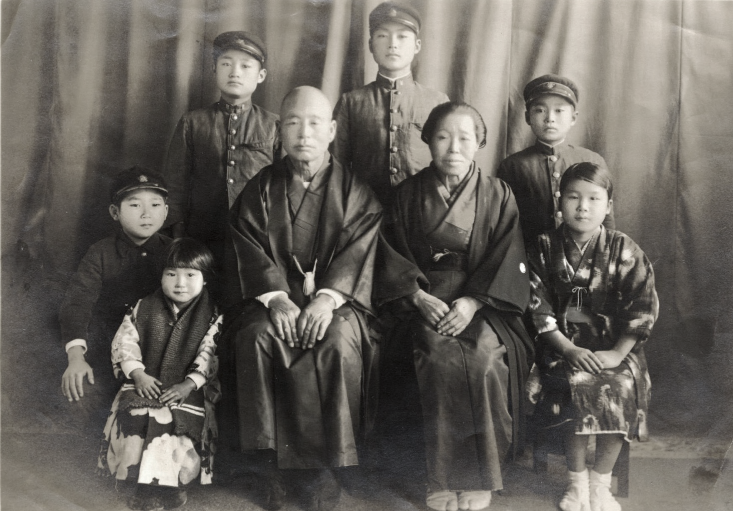
Notes:
Photo Set 5 Image B
Photo: Wakaji Matsumoto, Wakamatsu and Haru Matsumoto and grandchildren, Hiroshima, Japan, 1929.

Slide 27
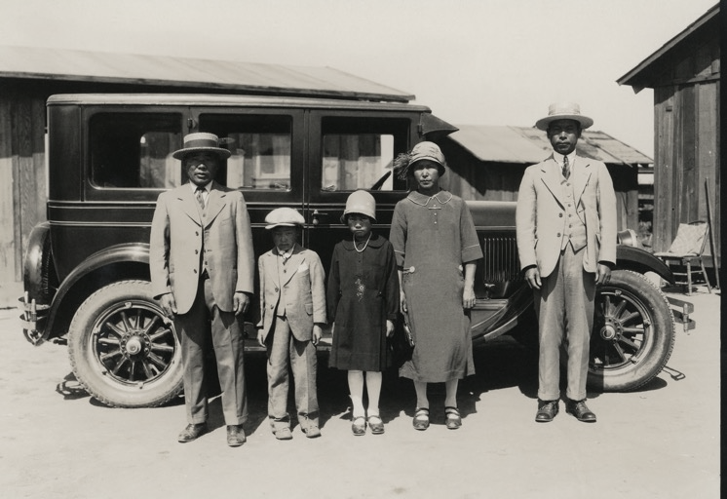
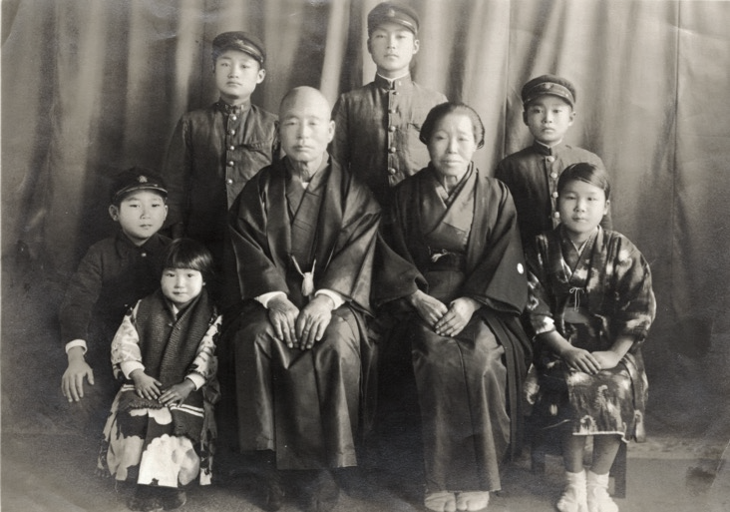
Notes:
Photo Set 5
Left (Image A): Wakaji Matsumoto, Japanese immigrant family at Los Angeles farm, Los Angeles, CA, 1927.
Right (Image B): Wakaji Matsumoto, Wakamatsu and Haru Matsumoto and grandchildren, Hiroshima, Japan, 1929.

Slide 28
Other tips and ideas
Print out pictures to give students closer access and a more “authentic” experience:
-Class sets or enlargements of actual photos
-Zoom in on elements of a picture
Don’t underestimate the power of images on a bulletin board – change them frequently
Each week choose a different photograph of a person or event in history for students to identify.

Slide 29
Thank you
ありがとうございます

